Slide 1
User manual
v 0.9

Slide 2
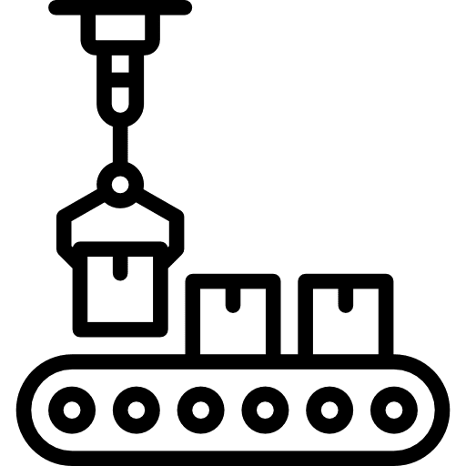

System Configuration
Vision system
Eject module
(1) acquisition
(5) eject signal
(4) eject signal
(2) vision analysis
Vision Software
Machine Controller
(3) Image Transfer
(4) Result
AI Software
Analysis system

Slide 3
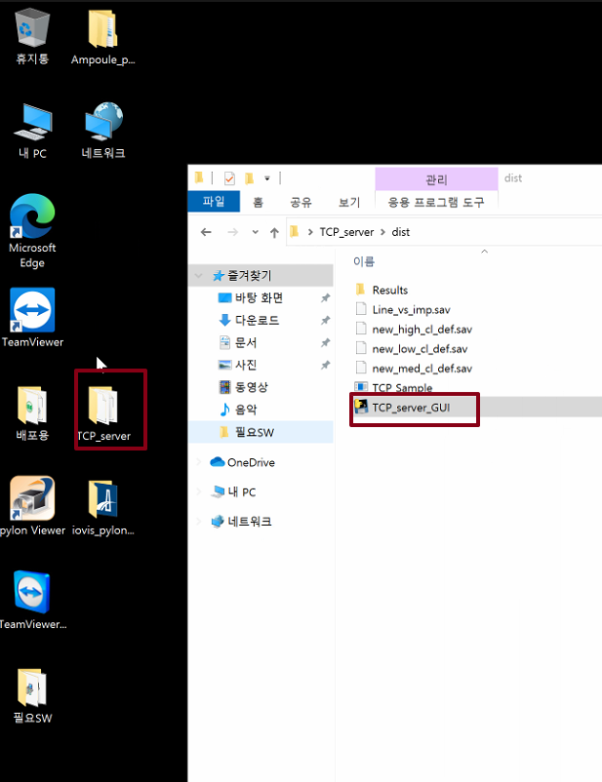
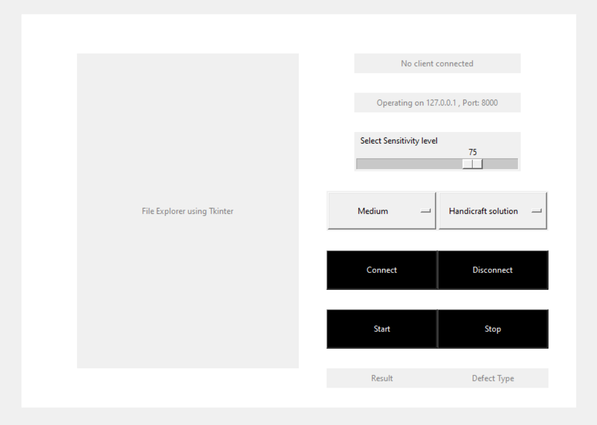
How to configure AI - Run and connect
Open ‘dist’ folder. Run TCP_server_GUI(AI Application)
Hit connect button
Check the connection status
3
1
2

Slide 4
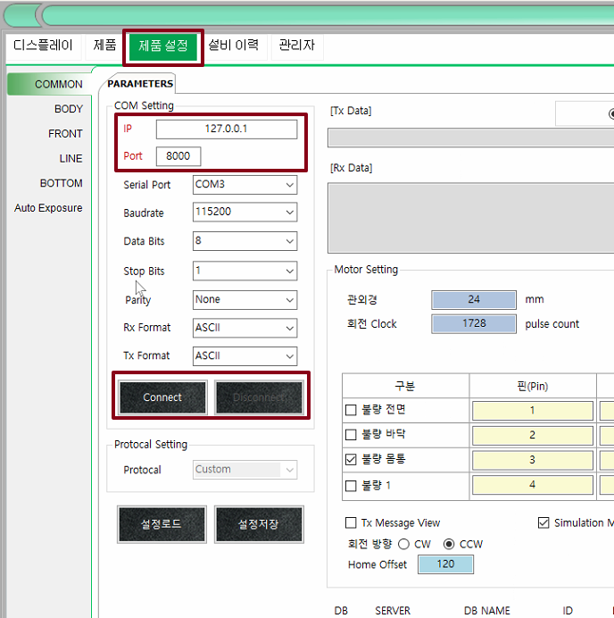
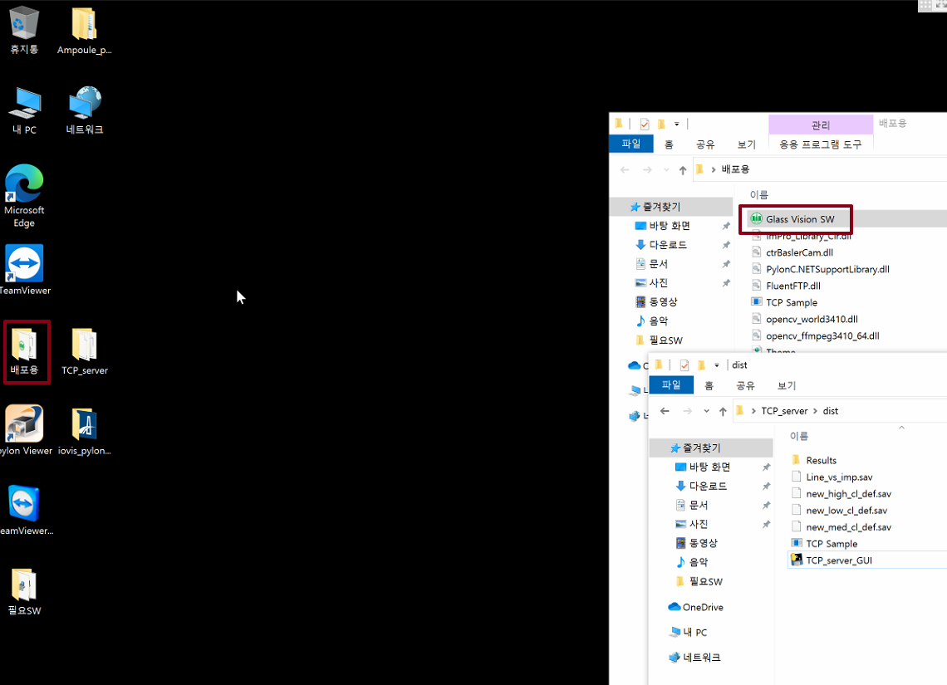
How to configure Vision - Run and connect
Run Glass Vision SW
Hit “제품설정” tab
Click Connect Button
2
1
3

Slide 5
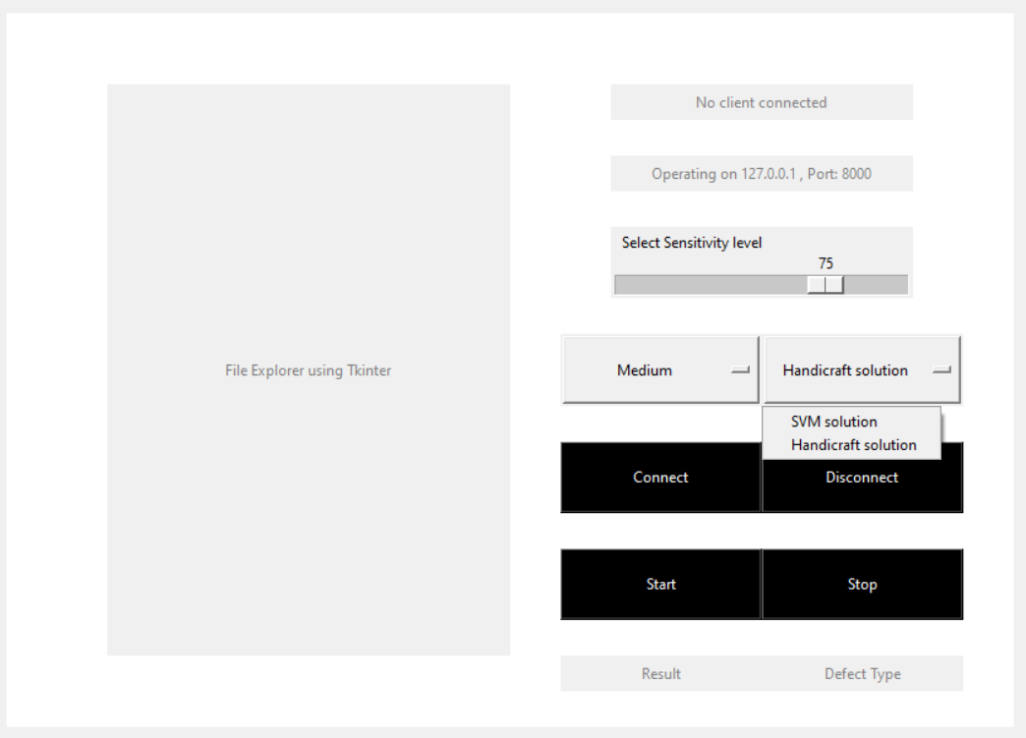
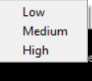
Select AI settings
Select method: Handicraft or SVM solution.
If handicraft solution, select sensitivity level from scale(Low sensitivity will detect only big defects and high sensitivity will detect even small defects).
If SVM solution select sensitivity level from menu(Low, Medium or High).
Finally press Start to start detecting.
2
1
3
4

Slide 6
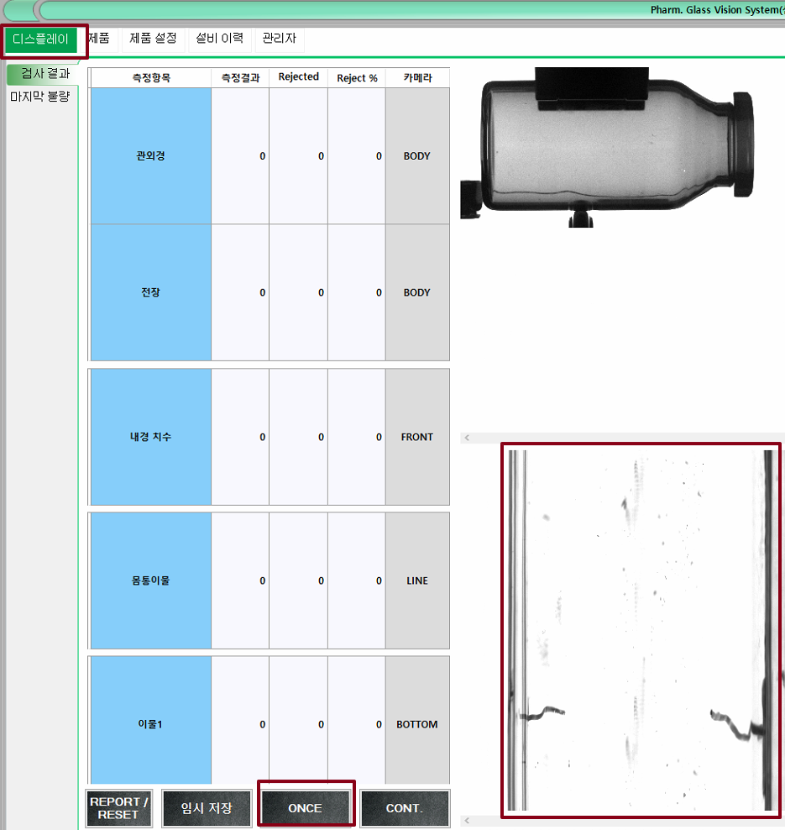
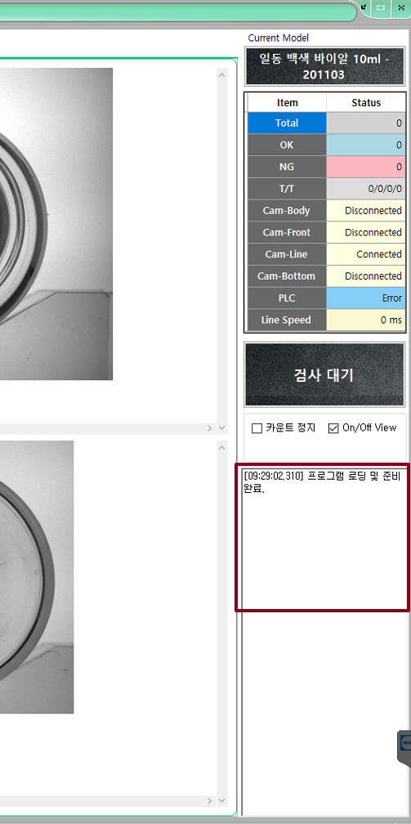
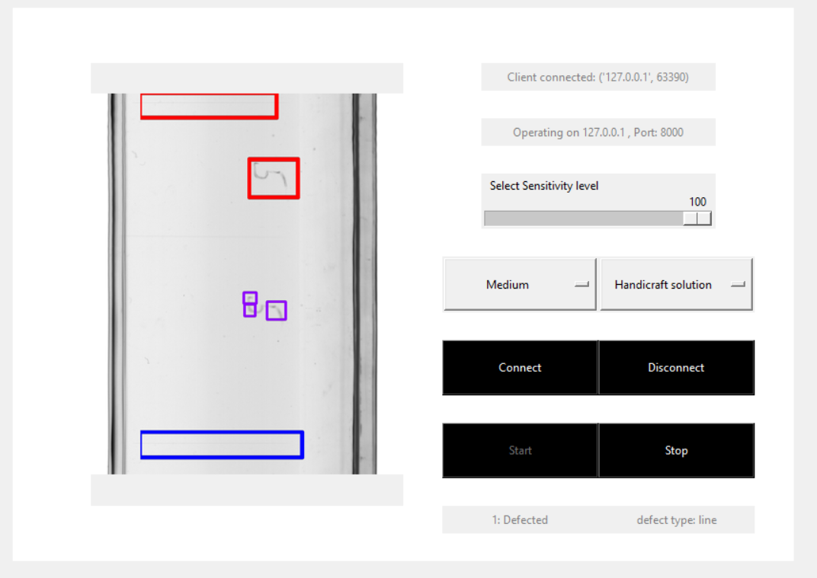
How to run
Move to “디스플레이” tab
Check the return value from AI such as “NG”
Check the given image with coloured boxes when AI detected (Red for scratch, Blue for line, purple for imprint).
Check result on AI(Clean or defected) and defect type(Line, Scratch or imprint).
3
1
2
4

Slide 7
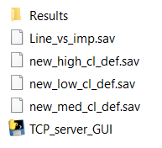

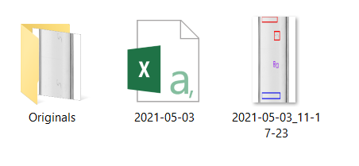
AI- Stop, Disconnect and Results
Press Stop to stop detection.
Press Disconnect to disconnect from Vision.
For results, go to the dist/results folder, open today’s date and there are 3 results:
3. Originals: Original images of bottles.
4. CSV file
5. Detected images
3
4
5
2
1

Slide 8
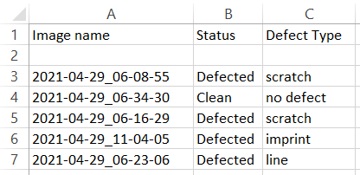
Results - CSV file
CSV file has:
Name of Image
Status: Clean or defective
Defect type: Line, Imprint or Scratch

